Slide 1
The CAT Theorem
Shegufta Ahsan, Indranil Gupta
Department of Computer Science
University of Illinois at Urbana-Champaign
DPRG: http://dprg.cs.uiuc.edu

Slide 2
Contributions
A new impossibility theorem ``CAT’’ for transaction-based distributed databases
C – Contention
A – Abort Rate
T – Throughput
Experimental Validation with 3 databases
1 NewSQL
2 Traditional RDBMs

Slide 3
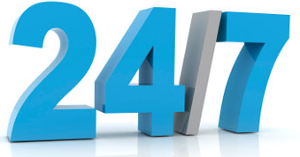
NoSQL database systems
Apache Cassandra, Riak, Dynamo, Voldemort…
Basic CRUD operations
Create, Read, Update, Delete
Low latency
High availability
Weak consistency

Slide 4
CAP Theorem [Brewer 00, Gilbert&Lynch 02]
Starting point for NoSQL Revolution
A distributed storage system can achieve at most two of C, A, and P.
Consistency – all nodes see same data/updates in order
Availability – all reads/writes succeed
Partition tolerance – C and A even under partitions
When partition-tolerance is important, you have to choose between consistency and availability
PACELC Variant [Abadi 12]: under partitions, choose between latency and consistency
Consistency
HBase, HyperTable,
BigTable, Spanner
RDBMSs
(non-replicated)
Partition-tolerance
Availability
Cassandra, Riak,
Dynamo, Voldemort

Slide 5
New Consistency Models and New CAPs
Red-Blue
Causal
Probabilistic
Since “eventual” NoSQL systems emergence, many have strengthened consistency while maintaining throughput
In SOSP 2015: Six papers supporting ACID with high throughput
Yesquel [Microsoft Research/VMWare], Tapir [U. Washington], Callas [U. Texas-Austin]
FaRM [Microsoft Research], RIFL [Stanford], DrTM [SJTU]
(Others: Hyperdex [Cornell])
Some researchers say CAP theorem invalid
Others say “P” in CAP should = “Performance” (Throughput)
Per-key sequential
Strong
(e.g., Sequential)
Eventual
CRDTs
Notes:
In 2012 Brewer clarified some of his positions, including why the often-used "two out of three" concept can be misleading or misapplied

Slide 6
CAP Alive, Impractical
CAP theorem is true, formally proved
There is a gap between the CAP theorem and the practical needs of today’s systems
Partitions are relatively rare
Availability is a fuzzy term
Need for a new theorem that captures performance limitations of ACID systems
Our CAT Theorem
Notes:
In 2012 Brewer clarified some of his positions, including why the often-used "two out of three" concept can be misleading or misapplied

Slide 7
CAP vs CAT
C – Contention
A – Abort Rate
T – Throughput
CAP | CAT
Consistency | Contention
Availability | Abort Rate
Partition Tolerance | Throughput

Slide 8
CAT Definitions
Contention: How much transactions overlap with each other
Abort Rate : Fraction of submitted transactions that are aborted
Throughput: Committed Transactions Per Second (TPS)

Slide 9
CAT Definitions (And Analogies to CAP)
Contention: How much transactions overlap with each other
Strongly consistent (Zero contention):
Immutable NoSQL System
ACID System supporting only read-only transactions
Abort Rate : Fraction of submitted transactions that are aborted
From client viewpoint:
Transaction Abort in ACID ≅ Unavailability for a CRUD op in NoSQL
Throughput: Committed Transactions Per Second (TPS)

Slide 10
CAT Theorem
No transactional database can support arbitrarily high levels of contention while yielding both a zero abort rate as well as high throughput.
(Or: Can’t get all 3 of C, A, T)
(CAT theorem does not replace, but sits alongside CAP theorem)
Notes:
When there are non zero contention in the system, the abort rate grows as the square of the throughput and thus the abort rate can not be zero

Slide 11
Some Simple CAT Scenarios
C – Contention
A – Abort Rate
T – Throughput
Scenario-I (C and A): Executing one transaction at a time (zero contention) → zero Abort rate, but low Throughput
Scenario-II (C and T): Executing all transactions concurrently → high Throughput, but increases the Abort rate
Scenario-III (A and T): Immutable database/Read-only transactions → both high Throughput and zero Abort rate

Slide 12
CAT Theorem “Proof” [Gray et al 96]
C – Contention
A – Abort Rate
T – Throughput
When there is contention across transactions, the abort rate increases at least as
Square of the throughput of the system
Third to fifth power of transaction size

Slide 13
Measurements

Slide 14
Measuring Contention
C – Contention
A – Abort Rate
T – Throughput
Our “Contention Level” metric
For a set of concurrent transactions
Common Objects are those objects that are accessed by at least 2 transactions in a set of concurrent transaction
Contention Level =
(total accesses to common objects) / (total number of accesses)
Lies in [0,1]

Slide 15
Measuring Contention
C – Contention
A – Abort Rate
T – Throughput
Example:
Three concurrent transactions:
T1 = {obj1, obj2, obj3}
T2 = {obj4, obj2, obj5}
T3 = {obj5, obj6, obj7}
Total number of common object accesses: 4
Total number of objects accessed: 9
Contention Level = 4/9 = 0.44

Slide 16
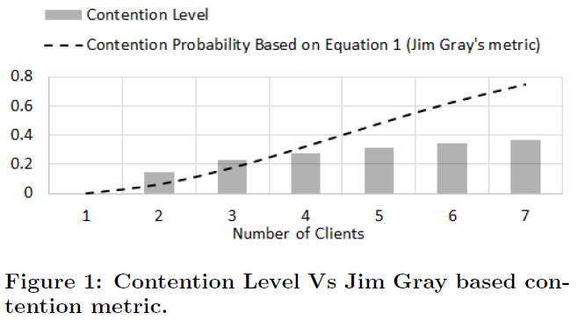
Contention Level Vs.
Vs. Jim Gray’s contention metric (Equation 1, works for Uniform Distribution only)
Overestimates abort rate
Vs. Real abort probability (based on serial equivalence rules)
Not exact, but parallel trend

Slide 17
Systems Chosen for Validation
Yesquel [Microsoft Research/VMWare SOSP 2015]
Amazon RDS
Microsoft SQL
(Fail: Tapir)
(Fail: Hyperdex)
(Unavailable: Callas)

Slide 18
Experimental Setup
Yesquel : All experiments were run on EmuLab cluster (3 servers, up to 7 clients).
We wrote a benchmarking tool in C++ (similar to YCSB+T)
MS Azure SQL, Amazon RDS : publicly available APIs were used.
We wrote the same benchmarking tool (YCSB+T) in C# and Java
Database contained total 1000 keys, total 10K transactions
Clients continuously send transactions one at a time

Slide 19
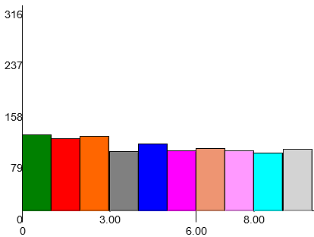
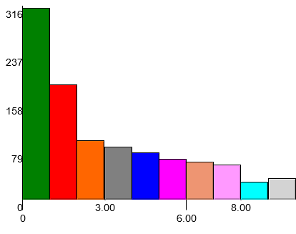
Variables
η = length of the transaction
η = 4 → { perform transaction on keys a,b,c,d}
η = 8 → { perform transaction on keys a,b,c,d,e,f,g,h}
α = Zipfian co-efficient. Higher value means some objects more popular.
α = 0.1, Total keys = 10 Total calls = 1000
α = 0.9, Total keys = 10 Total calls = 1000

Slide 20
Y = Yesquel, A = AWS RDS, M = MS SQL
C – Contention
A – Abort Rate
T – Throughput

Slide 21
Y = Yesquel, A = AWS RDS, M = MS SQL
C – Contention
A – Abort Rate
T – Throughput
As Contention Increases
Abort Rate Rises
Aggregate Throughput Rises

Slide 22
Y = Yesquel, A = AWS RDS, M = MS SQL
C – Contention
A – Abort Rate
T – Throughput
CA Scenario:
1 Client only =
No Contention
Zero Abort rate
But Lowest Aggregate Throughput

Slide 23
Y = Yesquel, A = AWS RDS, M = MS SQL
C – Contention
A – Abort Rate
T – Throughput
With Rising Contention
Per-client Throughput Decreases

Slide 24
Y = Yesquel, A = AWS RDS, M = MS SQL
C – Contention
A – Abort Rate
T – Throughput
MS SQL > AWS RDS (>? Yesquel): Surprising(?)

Slide 25
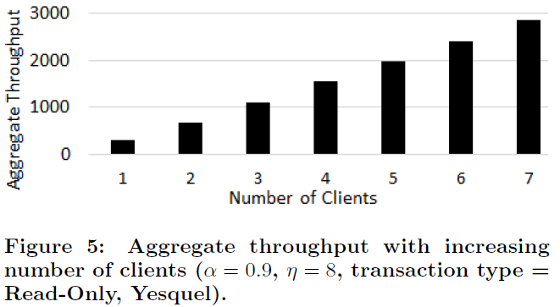
Zero Contention (AT Scenario, Yesquel)
C – Contention
A – Abort Rate
T – Throughput
All Read-only transactions → zero Abort rate
Increasing number of clients → Throughput rises linearly
When there is no contention, there are no aborts and throughput rises linearly

Slide 26
Effect of Transaction Overlap
Y = Yesquel
A = AWS RDS
M = MS SQL
Contention can also be increased by
Increasing transaction “overlap”
Increasing Zipf Coefficient (α):
Increases Contention Level
Increases Abort Rate
Decreases Throughput

Slide 27
Effect of Transaction Length η
Y = Yesquel
A = AWS RDS
M = MS SQL
Contention can also be increased by
Increasing transaction length
Result – same as before:
Increases Contention Level
Increases Abort Rate
Decreases Throughput

Slide 28
Takeaways
Transactional databases don’t mesh with CAP Theorem
Our new CAT Theorem states new, practical, impossibility
Cannot support high Contention, and achieve zero Aborts, and high Throughput, all at once.
Inspired by Jim Gray’s paper
New Contention Level metric
Validated with a NewSQL System (Yesquel) and 2 traditional RDBMSs (AWS RDS, MS SQL)
Further Directions:
CAP-like variants for transactional systems
Interplay of CAP and CAT theorems
CAT applied to transactional shared-memory models
DPRG: http://dprg.cs.uiuc.edu
Notes:
http://dataconomy.com/sql-vs-nosql-vs-newsql-finding-the-right-solution/
PACELC : https://brooker.co.za/blog/2014/07/16/pacelc.html

Slide 29
Backup Slides

Slide 30
Summary
A new impossibility theorem ``CAT’’ for transaction-based distributed databases :
No transactional database can support arbitrarily high levels of contention while yielding both a zero abort rate as well as a high throughput
CAT sits alongside the classical CAP and its variants
We propose a new Metric to measure the contention in a system
Notes:
http://dataconomy.com/sql-vs-nosql-vs-newsql-finding-the-right-solution/
PACELC : https://brooker.co.za/blog/2014/07/16/pacelc.html

Slide 31
CAT Theorem
No transactional database can support arbitrarily high levels of contention while yielding both a zero abort rate as well as a high throughput
Jim Gray 1996:: The dangers of replication and a solution
Notes:
When there are non zero contention in the system, the abort rate grows as the square of the throughput and thus the abort rate can not be zero

Slide 32
NewSQL systems
Modern relational database management systems
Provide the same scalable performance of NoSQL
Supports Online Transaction Processing (OLTP)
Maintains ACID guarantees
Atomicity
Consistency
Isolation
Durability

Slide 33
CAP-NoSQL Vs CAT-NewSQL
CAP – originally intended for CRUD supporting NoSQL system
CAT – intended for transactional/NewSQL system
“abort” in NewSql ↔ “unavailability” in NoSQL
Contention across transaction is an important factor
In CRUD, an immutable system supports strong consistency
In transactional system, if all transactions are read-only, there will be no abort

Slide 34
Our Contribution
Transactional-based distributed database (NewSQL) systems need a more practical version of a CAP-like impossibility theorem
One that is focused on realistic metrics:
Abort rate
Throughput
We propose the CAT impossibility theorem
C – Contention
A – Abort Rate
T – Throughput
We propose a new Metric to measure the contention in a system

