Slide 1
Service Fabric: A Distributed Platform for Building Microservices in the Cloud
Gopal Kakivaya*, Lu Xun*, Richard Hasha*, Shegufta Bakht Ahsan#, Todd Pfleiger*, Rishi Sinha*, Anurag Gupta*, Mihail Tarta*, Mark Fussell*, Vipul Modi*, Mansoor Mohsin*, Ray Kong*, Anmol Ahuja*, Oana Platon*, Alex Wun*, Matthew Snider*, Chacko Daniel*, Dan Mastrian*, Yang Li*, Aprameya Rao*, Vaishnav Kidambi*, Randy Wang*, Abhishek Ram*, Sumukh Shivaprakash*, Rajeet Nair*, Alan Warwick*, Bharat S. Narasimman*, Meng Lin*, Jeffrey Chen*, Abhay Balkrishna Mhatre*, Preetha Subbarayalu*, Mert Coskun*, Indranil Gupta#
# : University of Illinois at Urbana Champaign | * : Microsoft Azure
Presenter: Shegufta Bakht Ahsan
EuroSys 2018, April 23rd-26th | Porto, Portugal
DPRG@UIUC: http://dprg.cs.uiuc.edu Service Fabric: aka.ms/servicefabric

Slide 2
Microsoft Service Fabric
A distributed platform that enables building and management of scalable and reliable microservice based applications
Culmination of over 15 years of design and development
Skype
Microsoft Intune
Azure Cosmos DB
TalkTalk TV
Cortana
Microsoft IoT Suite
BMW
And More…
Microsoft Azure SQL DB:
Hosts ~2 Million DBs | Containing 3.5 PB of data | Spans over 100K machines
Azure Cosmos DB:
Utilizes 2 million cores | Spans over 100K machines
Cloud Telemetry Engine:
Processes 3 Trillion events/week

Slide 3
Monolithic Vs. Microservice Based Approach
App 1
App 2
Cannot scale out individual functions
Needs to scale out everything
Can Scale-out individual components
Load
Balancer
UI
Database
Cache
Node 1
Node 2
Node N
Business Logic
DB
Classic Monolithic Approach
Microservice Based Approach
Not Cloud Friendly
Cloud Friendly

Slide 4
Service Fabric and Its Goals
Support for Strong Consistency:
Ground Up
Higher layer focuses on “their” relevant notion of consistency (ACID at Reliable Collections)
Fault Tolerance
Support for Stateful Microservices:
Microservices can have their own state

Slide 5
Service Fabric Major Subsystems

Slide 6
Reliable Collection (Queue, Dictionary): [Highly Available] & [Fault Tolerant] & [Persisted] & [Transactional]
Reliable Primary Selection
Consistent Replica Set
Reliability Subsystem
Failover Management
Replicated State Machines
Leader Election
Consistency: Higher layers reuse lower layer’s, implementing their own notion of consistency
Routing Consistency
Reliable Failure Detector
Routing Token
Federation Subsystem

Slide 7
Federation Subsystem
0
Nodes are organized in a virtual ring (SF-Ring):
Consists of 2^{m} points (e.g., m=128 bits)
Key -> owned by the closest node
Neighborhood set: { ‘n’ successors, ‘n’ predecessors }
Ensures:
Consistent Membership and Failure Detection
Consistent Routing
Leader Election
40
8
10
12
15
18
30
20
28
25
22
26

Slide 8
Consistent Membership and Failure Detection
0
Design Principles:
Membership -> Strongly Consistent
For each node, all its monitors agree on its up/down status
Decouples Failure Detection from Failure Decision (using Arbitrator)
Lease Based Monitoring:
Node A sends Lease Request to Node B
If Node A receives ACK, lease stablishes
Symmetric Monitoring (SM)
Node A and Node B monitor each other
Node X (Decoupling Detection-Decision):
Maintains SM with all neighbors
If at-least one Lease fails (Detection)
ask for Arbitration (Decision)
40
8
10
12
15
30
18
22
20
28
26
25
Node 15 (Monitor 1)
Symmetric Monitoring
Node 20
Node 25 (Monitor 2n)
Symmetric Monitoring
Monitor | Lease Status
1 | OK
… | …
2n | OK

Slide 9
Arbitrator – Decouple Detection From Decision
Fail to renew lease (lease timeout Tm) (Detection)
Ask for arbitration immediately (Decision)
IF don’t receive any reply within Tm, leave!
ELSE follow arbitrators decision !
Arbitration Log
Log 1: Time T : Node B declared dead
In Production: Multiple Arbitrators, Quorum Based approach
Arbitrator
Node A
[2] Hey, I think B is dead !
[4] Hey, I think A is dead !
Node B
[3] Yes it is!
[5] It’s too late! You have to leave
[1] Symmetric Monitoring Failed

Slide 10
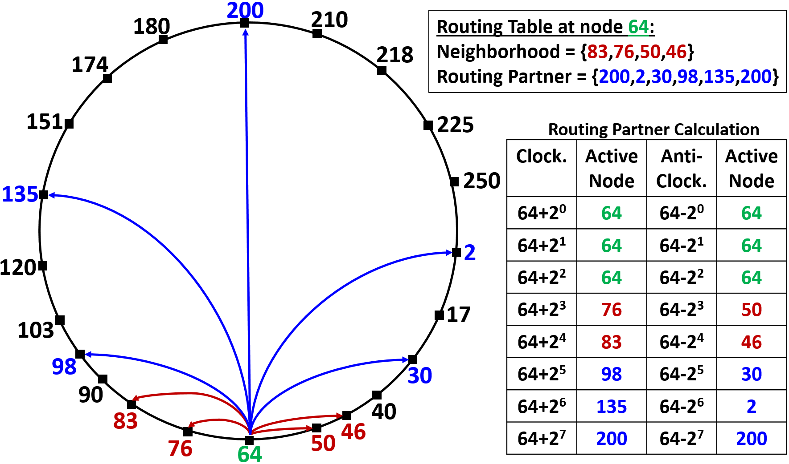
Routing is Bidirectional and Symmetric (SF-Routing)
i^{th} clockwise/anticlockwise routing table entry is the node whose ID is closest to the key (n +/- 2^{i})mod(2^{m})
SF-Routing:
Provides more routing options
Routes message faster
In latest design, SF-Routing is used for
Discovery routing when a node starts up
After Discovery, nodes communicate directly

Slide 11
Consistent Routing
At any given time all messages sent to key ‘K’ will be received by a unique Node. If that node crashes, a new node will take the responsibility
Leader Election: For entire system use K=0
Each Node owns a routing token:
A portion of the ring whose keys it is responsible for
SF-Ring ensures following consistency properties:
Always Safe: there is no overlap among tokens owned by nodes
Eventually Live: Eventually every token range will be claimed by a node
Efficiently Handle: Node Join, Leave and Fail

Slide 12
Consistent Routing
At any given time all messages sent to key ‘K’ will be received by a unique Node. If that node crashes, a new node will take the responsibility
Leader Election: For entire system use K=0
Each Node owns a routing token:
A portion of the ring whose keys it is responsible for
SF-Ring ensures following consistency properties:
Always Safe: there is no overlap among tokens owned by nodes (ensured by strong membership and failure detection)
Eventually Live: Eventually every token range will be claimed by a node
Efficiently Handle: Node Join, Leave and Fail
SF Ring
Is being used in production for more than 15 years
Working successfully, hence have not had to change it
Invented concurrent with Chord and Pastry
Chord/Pastry do not support Strong Consistency

Slide 13
Reliable Collection (Queue, Dictionary): [Highly Available] & [Fault Tolerant] & [Persisted] & [Transactional]
Reliable Primary Selection
Consistent Replica Set
Reliability Subsystem
Failover Management
Replicated State Machines
Leader Election
Consistency: Higher layers reuse lower layer’s, implementing their own notion of consistency
Routing Consistency
Reliable Failure Detector
Routing Token
Federation Subsystem

Slide 14
Reliability Subsystem
Provides:
Replication
High Availability
Load Balancing

Slide 15
Reliable Collection (Queue, Dictionary): [Highly Available] & [Fault Tolerant] & [Persisted] & [Transactional]
Reliable Primary Selection
Consistent Replica Set
Reliability Subsystem
Failover Management
Replicated State Machines
Leader Election
Consistency: Higher layers reuse lower layer’s, implementing their own notion of consistency
Routing Consistency
Reliable Failure Detector
Routing Token
Federation Subsystem

Slide 16
Reliable Collection (Queue, Dictionary)
Reliable Collections:
Fault Tolerant
Highly Available
Persisted, Replicated
Transactional
Leverages lower layer guarantees (Failure Detection, Leader election, load balance etc.)
Used in Stateful Microservices

Slide 17
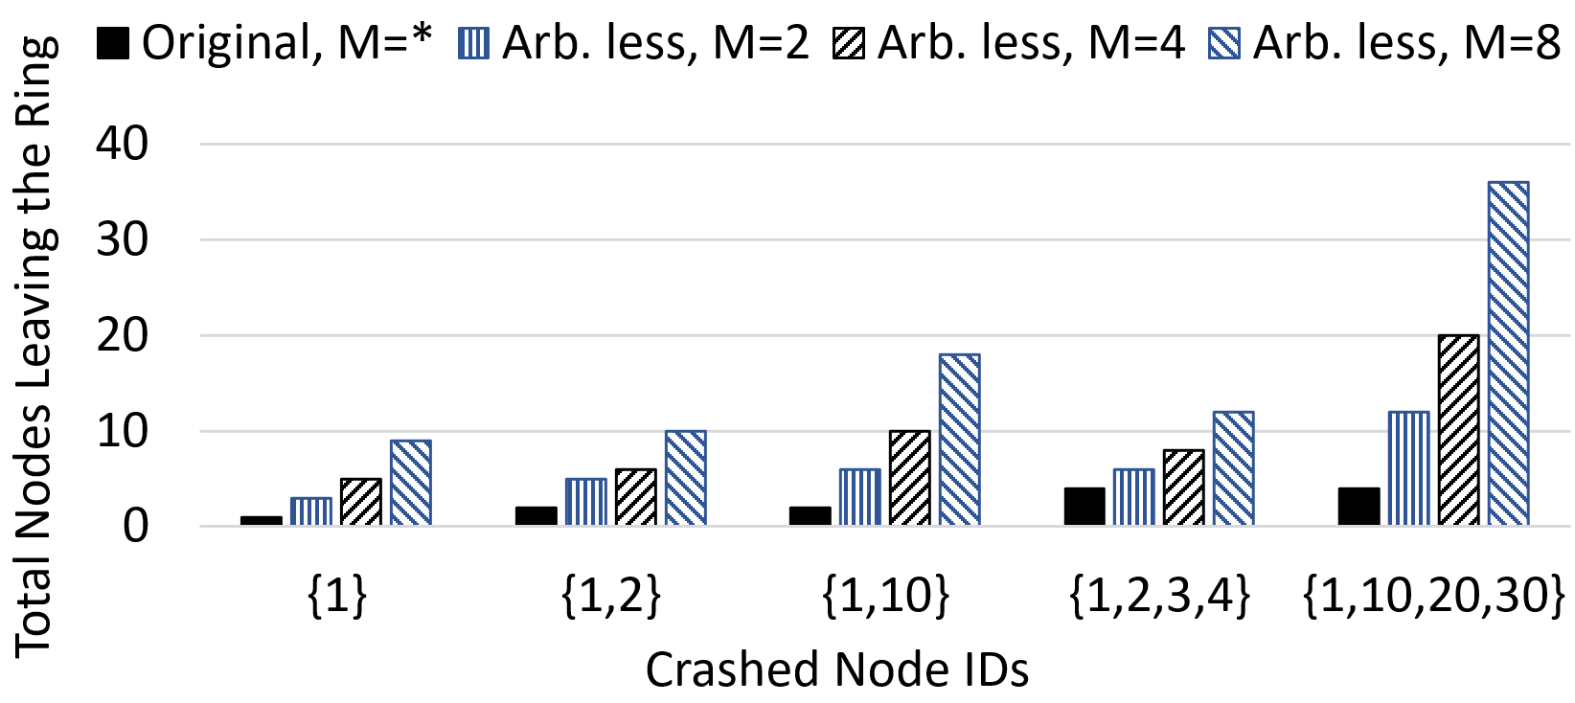
Evaluation – SF Arbitrator vs. Fully Distributed Scheme
SF arbitrator approach
If a node fails to maintain lease, it will gracefully leave the system It is the fully distributed way of maintaining strong consistency
Total neighbors
Scalable Failure Detector (SWIM): Not Strong
Arbitrator based FD:
Scalable
Strong Failure Detection
Prevents Cascading Failure
Does not depend on #neighbors
Cascading Failure
Strong Failure Detector (Virtual Synchrony): Not Scalable
20
10
8
5
6
4
4
1
2
2
Node 1 +
4 neighbors = 5
Node 1, 2 +
4 neighbors = 6
Single
Neighbors
Non-Neighbors
Neighbors
Non-Neighbors

Slide 18
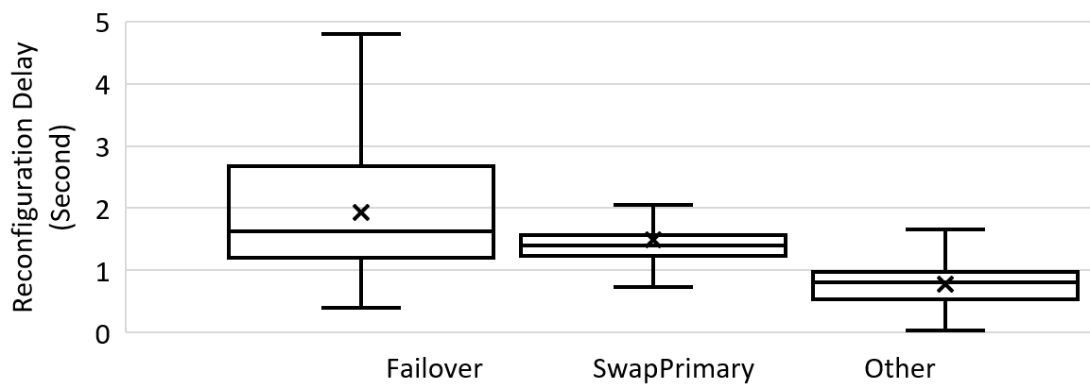
In Production: Reconfiguration Events + Reconfiguration Time
Affects Availability
e.g. Swap Secondary
Quick Control Decision (currently optimized to 100s of ms)

Slide 19
Evaluation (summary)
Arbitrator Based Strong Failure Detector:
Scalable (Minimum Failure Detection Overhead)
Prevents Cascading Failure
Uses less stabilization messages (Compared to the Arbitrator Less Scheme)
Does not get affected by the number of neighbors
Reconfiguration:
Control Decisions are generated quickly (avg 1~2 seconds)
SF’s current reactive reconfiguration approach is ensuring availability for ~10 million microservices

Slide 20
Evaluation (summary)
Message Delay:
Even in the presence of higher churn, message delay remains largely unaffected (80th percentile)
SF-Routing:
SF-Routing requires higher memory (117%) than Chord
Messages takes fewer hops (49.27%) than Chord and thus Routes Faster

Slide 21
Summary
Microsoft Service Fabric: A distributed platform that enables building and management of scalable and reliable microservice based applications
Service Fabric ensures strong consistency and fault-tolerance from lower layers, which helps us to build state at the upper layers
Selected Components:
Federation Subsystem, Reliability Subsystem, Reliable Collection (Queue, Dictionary)
Open Source: github.com/Microsoft/service-fabric
DPRG@UIUC: http://dprg.cs.uiuc.edu Service Fabric: aka.ms/servicefabric

