Slide 1
A New Fully-Distributed Arbitration-Based Membership Protocol
Shegufta Bakht Ahsan, Indranil Gupta
InfoCom 2020
DPRG@UIUC: http://dprg.cs.uiuc.edu
Dept. of Computer Science

Slide 2
Time Bounded Failure Detection
N3
N3
N3
N2
N1
N2
N1
N2
N1
Incorrect failure detection timeout leads to inconsistent Outcome!
N2 should wait for N1 to gracefully leave the system
Failure Detectors:
-Essential part of Membership Protocols
Used in:
Traffic routing
Multicast
Replication
Etc.
Also applies to Distributed Systems with replication, microservices orchestration, leader election etc.

Slide 3
Service Fabric: Scalable Consistent Membership Using Time Bounded Failure Detection
Weakly Consistent (WC) : SWIM, Ring-based heart beating, Gossip-style heart beating Strongly Consistent (SC) : Virtual Synchrony / View Synchrony
0
WC
SC
Consistency
40
8
(2a+1)
10
SC
WC
12
Scalability
15
18
30
20
28
25
22
26
Service Fabric
# Service Fabric [EuroSys 2018]
# Decouples: i) Failure Detection and
ii) Failure Decision
# Relies on a group of central arbitrator nodes (the green circle)
Time-Bounded
Consistency
WC, SC
Service Fabric

Slide 4
Contributions
Decentralize Service Fabric’s arbitrator group
Safe and Consistent Arbitrator Handoff
A coherent Node Join Protocol
Formal proof of correctness and time-bound of both approaches:
Neither Original Service Fabric paper nor any of its white papers provide the formal proof or time-bound

Slide 5
Service Fabric – Failure Detection: Leasing
Node Q
L_{PQ}
Node P
Lease Based Failure Detection between Neighbor P and Q
(Monitor P maintains lease L_{PQ} with monitored node Q. Monitor Q independently
maintains “Symmetric lease” L_{QP} with monitored node P - omitted due to simplicity)
T_{l}
26
12
ACK_{PQ(n)}
25
22
18
15
LR_{PQ(n+1)}
20
LR_{PQ(n)}
Neighbor in one direction n = 2
Neighbor(20) = {15, 18, 22, 25}
STATUS(L_{PQ(n)}) = Pending
STATUS(L_{PQ(n)}) = Established
STATUS(L_{PQ(n+1)}) = Pending
STATUS(L_{PQ}) = Alive
STATUS(L_{PQ})
= Timeout
Failure Detection
STATUS(Q) = Alive
L_{PQ(n)}
L_{PQ(n+1)}
STATUS(Q) = Suspected
Theorem (Failure Detection Time, T_{FD} with respect to the Leasing Interval, T_{l}): When Node Q fails, the failure detection time (T_{FD}) is bounded from both below and above, as: T_{l} ≤ T_{FD} < 2T_{l}
Theorem (Symmetric Lease Timeout): Without loss of generality, if L_{PQ} Times out at T_{PQ}, then its symmetric lease L_{QP} will also timeout at no more than T_{PQ} + 2T_{l} + T_{a} (where T_{a} is the arbitration timeout).

Slide 6
Service Fabric – Failure Decision: Arbitration
A : alive B : dead
A : alive B : dead
A : dead B : alive
A : dead B : alive
A : dead B : alive
Arb1
Arb2
Arb3
Arb4
Arb5
Centralized arbitrator group
Arbitration Timeout (T_{a}): if no response from arbitrator within T_{a} interval, the node will voluntarily leave the system
Failure Decision
Solid Lines:
messages that reach arbitrator first
{alive, alive,
dead, dead, dead}
Node A leaves
{alive, alive , alive,
dead, dead},
Node B winner
Node P
Node Q
Failure Detection
Corollary (arbitration requests interval between symmetric leases): Without loss of generality, if P detects Q as failed and send an arbitration request, then within T_{arbReqInt} time-bound, Q will also send an arbitration request, where T_{l} ≤ T_{arbReqInt} < 2T_{l}

Slide 7
Centralized Vs. Decentralized Arbitration
0
0
40
8
40
8
(2a+1)
10
10
12
12
15
15
18
18
30
20
30
20
28
25
22
28
25
22
26
26
Centralized arbitration
Majority of the arbitrator fails → the entire ring will collapse
Requires special deployment
Remove dependency over the centralized group
Centralized arbitrator’s responsibility is distributed across the partially overlapping neighborhood of the ring
Does not require special deployment

Slide 8
Pair-wise Arbitrator Formation
0
0
40
8
40
8
(2a+1)
10
10
12
12
15
15
18
18
30
20
30
20
28
25
22
28
25
22
26
26
Service Fabric: Centralized arbitrator group for all neighboring pairs
Our proposed approach: Each neighboring pair maintains separate arbitrator group
Neighbor in one direction `n’ = 2
For Lease L_{20,18}, N-20 maintains an arbitrator group for N-18
Arb_{20,18} = 20 U Neighbor(20) U 18 U Neighbor(18)
= 20 U {15, 18, 22, 25} U 18 U {12, 15, 20, 22}
= {12, 15, 18, 20, 22, 25}

Slide 9
Forming the Pairwise Arbitrator Group
For the pair P↔Q, the symmetric leases are L_{PQ} and L_{QP}
For L_{PQ}, Node P: maintains an arbitrator group for Node Q,
A_{PQ} = {O, P, Q, R}
Should be Consistent
For L_{QP}, Node Q : maintains an arbitrator group for Node P,
A_{QP} = {O, P, Q, R}
If O fails P cannot unilaterally change A_{PQ} to {N, P, Q, R}
Neighbor in one direction `n’ = 1
M | N | O | P | Q | R | S | T
P initiates the arbitration handoff protocol
A_{PQ} = {N, P, Q, R}
A_{QP} = {O, P, Q, R}
9

Slide 10
Arbitration Handoff (2 phase)
Node P
Node
Q
Phase 1 (Propose):
P proposes the modified arbitrator group to the old arbitrator group
Majority times out: P leaves the system
Majority rejects: P sticks to the current group
Majority approves: P change to the new group and explicitly notify Q
Phase 2 (optional - propagate):
Next lease request from P to Q piggybacks the approved decision
Please check paper for details
PROPOSE(A_{PQ(ver1)})
LR_{PQ(n)}
ACK_{PQ(n)}
Old Arb
ACCEPT(N_{P(ver1)})
T_{l}
A_{PQ(ver1)}
Phase 1
LR_{PQ(n+1)}|A_{PQ(ver1)}
ACK_{PQ(n+1)}
Phase 2 (Optional)
M | N | O | P | Q | R | S | T
Theorem (Maximum inconsistency interval between A_{PQ} and A_{QP}): If P successfully updates to A_{PQ(ver_n)} at time T, then Q will reflect the same upgrade no more than time T + 2T_{l}
Theorem (Time-based Consistency): After Node Q fails, within another (T_{a} + 4T_{l}) time units: i) Q leaves the system and ii) all of Q’s monitors know about Q’s failure

Slide 11
Contributions
Decentralize Service Fabric’s arbitrator group
Safe and Consistent Arbitrator Handoff
A coherent Node Join Protocol
Formal proof of correctness and time-bound of both approaches:
Neither Original Service Fabric paper nor any of its white papers provide the formal proof or time-bound

Slide 12
Node Join in Decentralized scheme (4 phase)
Candidate Node C
Phase 1 (Neighbor Discovery):
Candidate Node `C’ discovers its 2n neighbors
Phase 2 (Lock Request):
C sends lock request to all of its 2n potential neighbors
Retry if at least one lock request gets rejected. Else proceed
Phase 3 (Lease Invitation):
For each neighbor P, C initiates first lease L_{CP} and sends lease request LR_{CP(1)}
Once received, Node P sends its Lease request LR_{PC(1)} along with the Lease Ack ACK_{CP(1)}
Phase 4 (Wrap-up):
Both C and P establishes symmetric leases L_{PC} and L_{CP}, also independently maintains arbitrator group A_{CP} and A_{PC}
For details – please check the paper
Node P
DiscvrNgbr(C)
T_{l}
Phase 1
LKRQ_{CP}
GRANT_{CP}
Phase 2
LR_{CP(1)}
ACK_{CP(1)}|LR_{PC(1)}
Phase 3
ACK_{PC(1)}
LR_{CP(2)}
ACK_{CP(1)}
Phase 4
LR_{PC(2)}
ACK_{PC(2)}

Slide 13
Evaluation: Failure Detection Time (EmuLab)
Theorem (Failure Detection Time, T_{FD} with respect to the Leasing Interval, T_{l}): When a node Q fails, the failure detection time (T_{FD}) is bounded from both below and above, as: T_{l} ≤ T_{FD} < 2T_{l}
Candle Stick Plot: 1st, 2nd and 3rd quartile, X points the average
Avg Failure Detection Time 1.5T_{l} Coherent with the Theorem
Various Leasing Intervals (T_{l})
Deployment: 64-member group in an EmuLab cluster with five d710 nodes (2.4GHz 64-bit quad core xeon processor, 8MB L3 cache, 12 GB DDR2 Ram. Neighbor count per direction = 3

Slide 14
Evaluation: Distributing the Arb. Msg Overhead
Simulation over 1000 nodes N = 3 (Neighbor count in each direction)
f = 100 (simultaneous failure count)
Centralized scheme: for ‘f’ failure, each arbitrator receives “2Nf = 600” messages
De-centralized scheme distributes the load. Max 24 msg per arbitrator

Slide 15
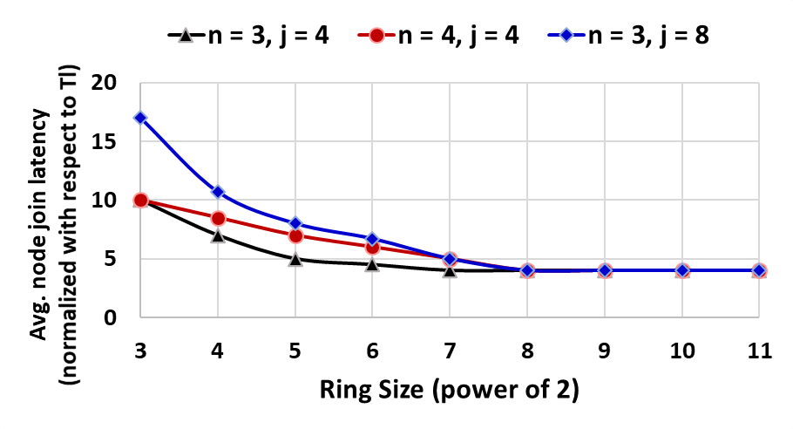
Evaluation: Node Join Latency
Larger ring causes less conflicts, hence new node can join fast
→ high scalability

Slide 16
Evaluation: Impact of Arbitrator Failure
DA – Distributed Arbitration scheme
CA – Centralized Arbitration scheme
Centralized Arbitration – Entire Ring Collapses

Slide 17
Contributions
Decentralize Service Fabric’s arbitrator group
Safe and Consistent Arbitrator Handoff
A coherent Node Join Protocol
Formal proof of correctness and time-bound of both approaches:
Neither Original Service Fabric paper nor any of its white papers provide the formal proof or time-bound

