Slide 1
Home, SafeHome: Smart Home Reliability with Visibility and Atomicity
Shegufta B. Ahsan, Rui Yang, Shadi A. Noghabi, and Indranil Gupta
Department of Computer Science, University of Illinois at Urbana-Champaign Microsoft Research
Notes:
Hi Everyone, I’m Rui from UIUC. Today I’m going to introduce how to make our smart home more reliable, predictable and safe, with our system Safehome. This is a collaborative work with Microsoft Research

Slide 2
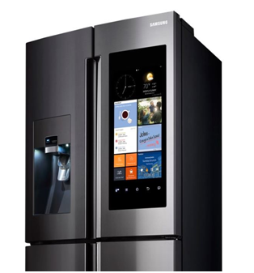
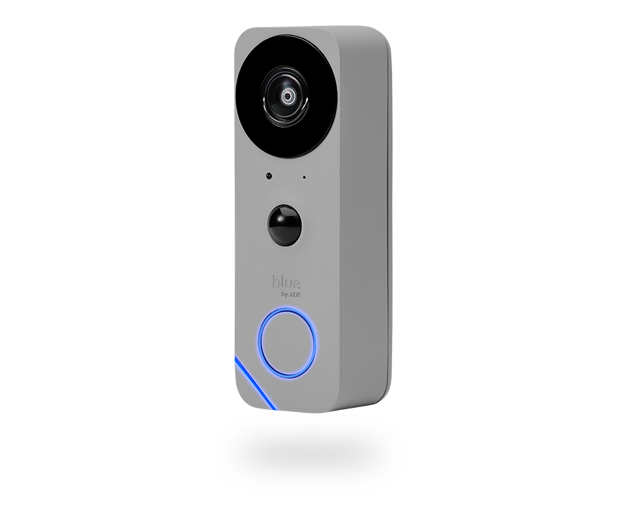
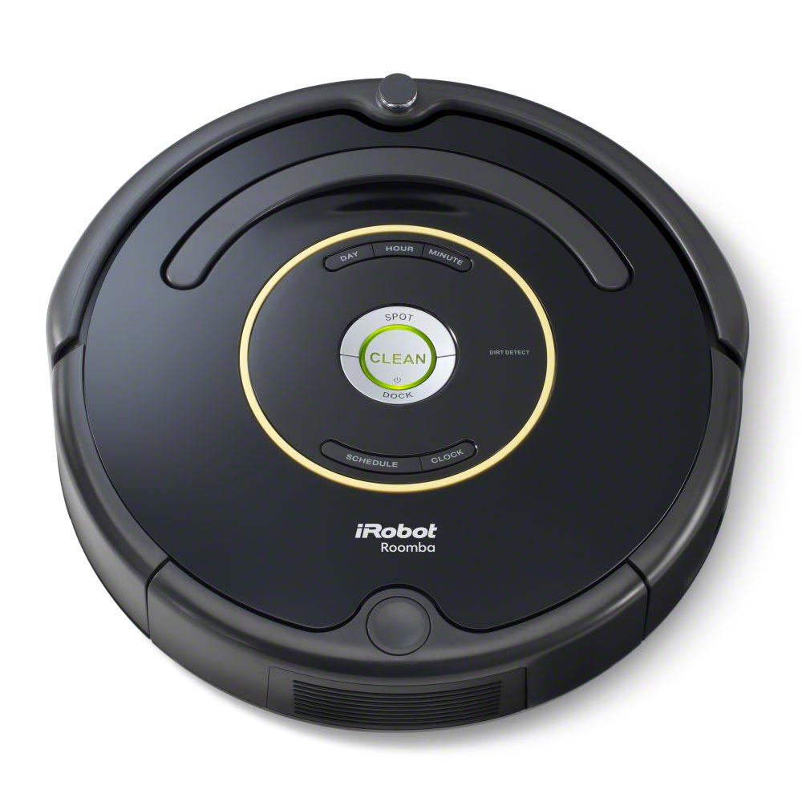
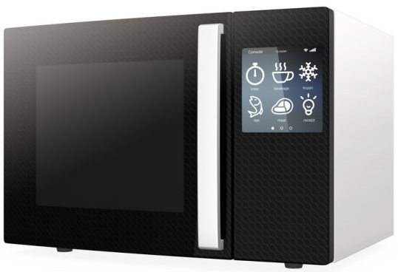
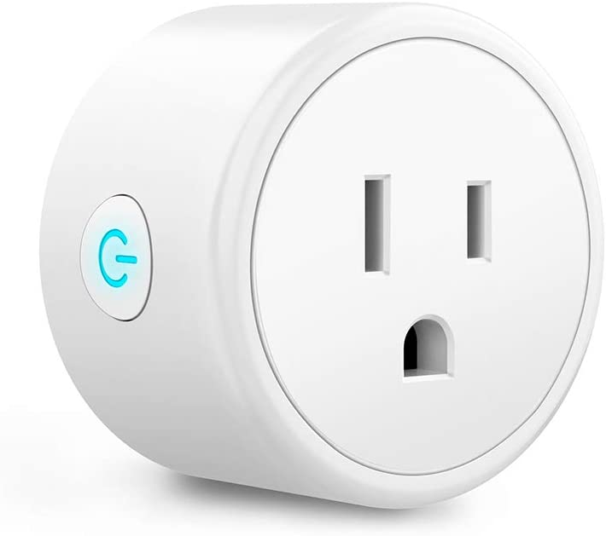
Smart Home World
Smart Device: 1) connected to other devices via wireless protocols
2) controlled by home automation systems
Notes:
In the smart home world, we have many kinds of smart devices such as smart light, smart fridge and etc.
The smart devices we refer here are those who can connect to the networks
and be accessed and controlled by home automation systems.

Slide 3
Smart Home World
Smart Device: 1) connected to other devices via wireless protocols
2) controlled by home automation systems
“Humans need to control their lives, not control devices.”
-- Davidoff et al, UbiComp’06
Notes:
Let’s just think about. When we are setting up or using the smart devices, what are in our minds.
Controlling a single action of a specific device? No, we want to control our lives. We want to make our lives easier.

Slide 4
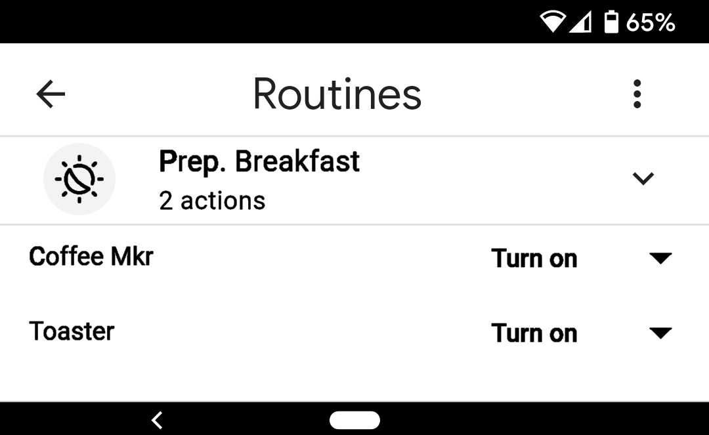
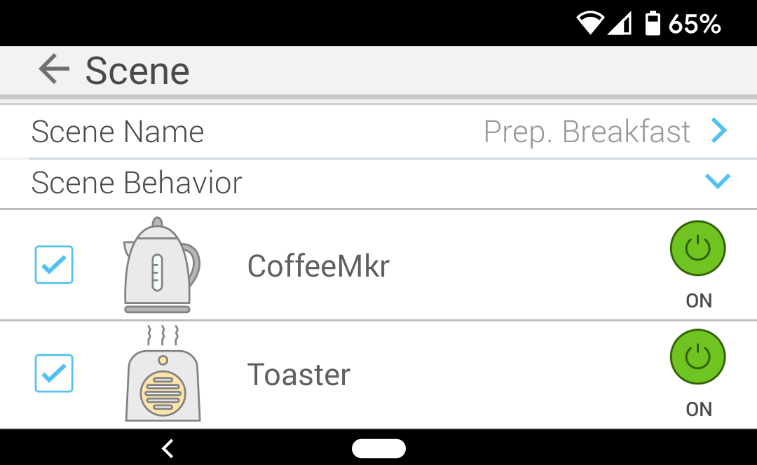
Smart Home World (Cont.)
How people control smart home?
by Command e.g. {Make an espresso}
by Routine: a sequence of commands e.g. Prep. Breakfast = {Make an espresso; make a pancake}
Current systems execute Best-Effort!
Routine in Google Home
Routine in Kasa (TP-Link)
Notes:
Then how do people control smart homes nowadays? Either through command, for example: make an espresso
Or through routine, which is a sequence of commands on the same or usually different devices. For example, make an espresso and make a pancake.
The status quo systems execute commands and routines in a best-effort way. They instantaneously attempt what are initiated, no matter what is running or whether there’s any failure. However, such way of execution misses two natural expectations from users.
The status quo systems execute commands and routines in a best-effort way. They instantaneously attempt what are initiated, no matter what is running or whether any device suffers any failure. However, such way of execution misses two natural expectations from users.

Slide 5
Two Natural Expectations from Users
Execute everything in a routine – Atomicity
All commands in the routine need to finish successfully, or none do
When conflicts happen, people hope routines to execute one after another – Isolation / Serial Equivalence
*Routines are common to be long running, e.g. trash-out routine.
R1:
Trash-out
Poorly supported in current systems!
R2:
Close
Gar. Door
Notes:
When users put a bunch of commands in a routine, they expect to execute them ALL together. This is essentially atomicity, which is a well-known property.
Another expectation is that, when two different routines touching the same devices are triggered together, people expect them to run isolated so that their results do not affect each other. By that we mean, we want the system outcome to be equivalent to the routines being executed one after another, which is serial equivalence.
A simple example is a scenario with a routine that opens the garage door, moves the trash can out, and closes the door. At the meantime, if another routine of “closing garage door” is triggered but before the trash can moves out, the trash can will not able to get out for garbage collection. or even worse, hit the door. Here, users would strongly expect these two routines to run one after another.
However, such guarantee is poorly supported in nowadays systems. In our exploration with TP-Link smart plugs, the interleaved execution occur unignorably.
Another missing support is long running routines. Such routines have long running intents from the users or by the device actions themselves. This brings extra challenges for a system to provide user-facing atomicity and isolation.
Another missing support in nowadays systems is long running routines. Such routines have long running intents from the users or by the actions themselves. For example: moving the trash can out cannot be done in one second. This brings extra challenges for a system to provide a user-facing atomicity and isolation.

Slide 6
SafeHome
Home Automation System that can
Support long running routines
Properly isolate concurrent routines (providing serial equivalence)
Ensure routine execution atomicity
Key challenge: Actions are visible to users
Methodology:
Four Visibility Models (Spectrum for user choices)
Lock-based mechanism with leasing design
Notes:
Thus, we propose SafeHome, a home automation system that supports long running routine expression, can properly isolate concurrent routines through providing serial equivalence, and can ensure routine execution atomicity.
The key and unique challenge for Safehome is that every system action is immediately visible to users. Any delay or device state change has higher physical world impacts compared to non-smart-home systems.
Thus, in Safehome, we introduce four Visibility Models. They provide a spectrum between latency and temporary incongruence which we will introduce later. In the models, we utilize lock-based mechanisms with leasing designs to help routine scheduling and execution.

Slide 7
Visibility Models
Four Visibility Models:
Weak, Eventual, Partitioned Strict, Global Strict
Example Scenarios: 5 routines are initiated simultaneously on 4 devices
3 Routines Initiated by User:
2 Routines triggered by other sensors:
Coffee Maker
Pancake maker
Vacuum
Mopper
R1:
R4:
(espresso)
(vanilla)
(living room)
(living room)
R2:
R5:
(americano)
(strawberry)
(kitchen)
coffee maker
pancake maker
R3:
vacuum
(plain)
mopper
Notes:
The Visibility models we proposed include Weak, Eventual, Partitioned Strict and Global Strict. Let me introduce them with an example.
We have 5 routines touching 4 devices. We colored these devices differently.
Three of the routines are initiated by 3 residents of the house to cook different breakfast.
Two other routines are sensor-triggered to clean the living room or the kitchen. All routines are triggered at the same time, and we assume each command need to run 1 time unit and run sequentially inside one routine.
We have 5 routines touching 4 devices, including coffeemaker, pancake maker, vacuum and mopper. We color different device in different colors.

Slide 8
Weak Visibility (WV) Model -- Status Quo
Strategy:
Execute routine immediately when triggered
Finish in 2 time units
Insertion time
time
R1
R1
Two commands send simultaneously to one device may cause errors.
R2
R2
R3
Parallel Execution
R4
R4
coffee maker
R5
pancake maker
vacuum
mopper
Notes:
Let’s take a look at the status quo design. We call it Weak Visibility model. It executes routine immediately when it triggers. Thus, all routines execute in parallel and can finish in two time units.
However, sending two commands simultaneously to one device may cause errors. For example, the first command may get interrupted, or more commonly the second command gets ignored.
If we don’t want to see these potential errors,
However, sending two commands simultaneously may cause errors, for example one command might interrupt the execution the other one.

Slide 9
Global Strict Visibility (GSV) Model
Strategy:
Execute at most one routine at a time
Strongest Visibility Model
Example Usage: resource constrained environment:
e.g. 1000-watt max supply < coffee maker 600W + pancake maker: 600W
Finish in time units
8
Insertion time
time
R1
R1
R2
R2
R3
R4
R4
R5
coffee maker
pancake maker
vacuum
mopper
Notes:
the strictest way is to only execute one routine at a time. We call it Global Strict Visibility Model. It takes 8 time units to finish.
GSV is very strict, but is still useful in those cases with resource constraints like energy. When there are limited maximum power supply, GSV can guarantee that the circuit breaker does not trip.
However, GSV is too strict in most cases. Thus, a slightly less strict model would be
GSV is very strict, so it has limited use cases, but it is still useful in those cases with resource constraints like energy. When there are limited maximum power supply. GSV can help to guarantee that the circuit breaker does not trip.

Slide 10
Partitioned Strict Visibility (PSV) Model
Strategy:
Routines touching disjoint devices do not block each other
Useful when routines need to execute without interference through duration.
Might still takes long with long running routines.
Finish in 5 time units
Insertion time
time
R1
R1
R2
R2
R3
Parallel Execution
R4
R4
R5
Notes:
Partitioned Strict Visibility model. It allows routines touching disjoint devices to execute in parallel. This model can finish our example in 5 time units.
PSV is useful when the commands have implicit dependencies so the user expects the whole routine to execute without interference.
However, PSV can still take tens of minutes to execute with those long running routines. Thus, it’s still not ideal. Then can we do better?

Slide 11
Eventual Visibility (EV) Model
Strategy:
Routines can concurrently execute without violating some serial order.
Finish in time units
3
Insertion time
time
R1
R1
R2
R2
R3
Parallel Execution
Equivalent end state to: R3 –> R1 –> R2 –> R5 –> R4
R4
R4
R5
Notes:
Look back to our examples. Even for the routines touching the same devices,
we can still place them in a way so that they can execute in parallel and follow some serial order.
In the example placement shown here,
it takes 3 time units to finish. And the five routines end with the system state equivalent to if running them in order 3 -1 -2 -5 -4. This is the Eventual Visibility model that we have.
The way we achieve this design is by using locks.
it takes 3 time units to finish. And the five routines end with the system state equivalent to running them in order 3 -1 -2 -5 -4. This is the Eventual Visibility model that we have. Even though in the middle, there are times that violate the isolation, but eventually at the end, it can provide serial equivalence guarantee.
The way we achieve this design is by using locks.
So go back to EV model. With our R1-R5 examples, when a routine comes and finds out there are chances for pipelining, it will take the spot. In such case, R2, R3 and also R5 have chances to execute earlier. EV model takes only 3 time unit to finish.
At the meantime, the end state after all five routine finishes are equivalent to the serial order Routine 3 – 1 -2 -5 – 4. This provides users better system explanablity.
To schedule these routines into such timeline, EV utilize the post-lease and pre-lease mechanism.

Slide 12
Eventual Visibility (EV) Model
Strategy:
Routines can concurrently execute without violating some serial order.
Each routine holds the locks for devices it touches (but can lease the lock).
No code needed
Post-lease
Managed at
Pre-lease
central device
(e.g. hub)
Notes:
Note that the locks here are all held at the central device. All Safehome logics sit here. No code is needed at other smart devices.
So goes back to our EV model. Each routine holds the locks for the devices it touches, but can lease them out under certain conditions.
The intuition of leasing is to pipeline the routines when device is idle. We support post-lease and pre-lease.
To schedule these routines that can interleave but still eventually follow some serial order, we utilize the post-lease and pre-lease mechanisms.
.
An idea is that even when routines are touching the same devices we still allow them to run in parallel, this is what we call EV. It’s called eventual because in the middle, there might be time that things are not exactly what users expect, but once everything is executed, it will end up with system outcomes that following some serial order. The way we do it is using locks.

Slide 13
Eventual Visibility (EV) - Post-Lease
Post-lease:
If a routine is done with a device D, it can post-lease D’s lock to another routine.
Insertion time
time
R1
R1
Serial order:
lessor –> lessee ( R1 –> R2 )
R2
R2
post-lease
R1 will be done with coffee maker
Notes:
In post-lease, if a routine is done with a device, it does not have strong need to lock it so it can lease the lock out.
For example, after R1 has finish making the coffee,
it can let R2 to start.
The serial order under post-lease is always “lessor happens before lessee”.
(Longer version: constraints)
The intuition of leasing to pipeline the routines when device is idle. We support post-lease and pre-lease.

Slide 14
Eventual Visibility (EV) - Pre-Lease
Pre-lease:
If a routine has acquired the lock but not accessed a device D, it can pre-lease D’s lock to another routine.
Insertion time
time
R1
R1
Serial order:
lessee –> lessor ( R3 –> R1 )
R2
R2
pre-lease
R3
R1 will start to access pancake maker
Notes:
With a similar intuition, in pre-lease,
if a routine has acquired a lock but has a while before it accesses the device, it can lend the lock to another routine, which uses it and returns it.
This happens to the pancake maker in R1,
where EV can start R3 immediately.
In pre-lease, the serial order is always “lessee happen before lessor.”

Slide 15
Eventual Visibility (EV)
EV finishes routine
with short wait and provides serial equivalence
with higher temporary incongruence: intermediate state is not serially equivalent
Finish in 3 time units
Insertion time
time
R1
R1
R2
R2
R3
pancake and coffee maker can not be both ON under any serial order
Notes:
In summary, EV model can provide short waiting time and serial equivalence guarantee.
But in the middle, there might be times that violate the serial equivalence, which we call temporary incongruence.
As in our example, pancake and coffee maker cannot be both ON under any serial order.
However, such incongruence is ONLY temporary. It will get fixed automatically at the end. And that’s why we call this model eventual.

Slide 16
Eventual Visibility (EV) - Lineage Table
Lineage Table: SafeHome's plan of which routine will access which device.
[A]: Get lock Access
[S]: Routine Scheduled
[L]: Lock Leased out
[R]: Lock Released
R1[A]
R2[S]
R3[A]
R1[L]
R2[S]
R4[A]
Scheduling plan placement:
Placed when routine is triggered
Use backtracking for valid placement
Explore two other policies (FCFS, JiT)
R5[R]
R4[A]
Notes:
Safehome manages the logic of EV with lineage table. It maintains, at each time, which routine will access which device so that the execution can follow a potential serial order.
Here is the lineage table for our example. Each table entry is marked with status of
Holding the device access,
Scheduled,
Lock leased out, or
Lock released
SafeHome handles dynamically arriving routines. I described a static scenario here just for simplicity.
Also, to reduce the search space, SafeHome utilizes backtracking to decide valid routine placement.
We also explores two other scheduling policies of First-Come-First-Serve and Just-in-Time. If you are interested in more details on this slide, welcome to read the paper.
So far, the designs are focusing on the serial equivalence. But there is another property that we care about, which is atomicity. It relates to the design when failure happens.
The table entries are constructed when routine is triggered.
We also explores two other scheduling policies of First-Come-Fist-Serve and Just-in-Time. If you are interested in more details about the lineage table and these scheduling policies, welcome to read the paper.

Slide 17
Failure Serialization and Rollback
Device might fail:
Rollback? Try to serialize the failure/restart event!
If the failed device is not touched by the routine:
Arbitrary Serial Equivalence order
If device fails/restarts after the last touch:
Routine –> Fail/Restart Serial Equivalence order
If device fails/restarts before the first touch:
Fail/Restart –> Routine Serial Equivalence order
If device fails/restarts during the touch:
Rollback routine
Start Execution
R1
R1
and/or
time
and/or
and/or
and/or
Failure –> Restart –> R1
R1 –> Failure –> Restart
Notes:
A naive way to provide atomicity is rollback, but it might cause high physical world impact. Thus, SafeHome minimizes rollbacks by serializing the failure and restart events together with routine execution. Here is how it work in EV.
If the routine does not touch the failed device. We can serialize it in arbitrary order.
If the routine has finished with that device and the failure happens afterwards. This result is equivalent to serializing the routine before the failure.
Similarly, if the device fails or recover before the routine touches it for the first time. we serialize the routine after the failure or restart.
If the device fails when the routine is touching it, we have to fail the routine itself.
If the routine has finished with that device and the failure happens afterwards. This result is equivalent to executing the routine first and then the device fails after the routine finishes. In other words, we serialize the routine before the failure.
(record ~57’30’’)

Slide 18
SafeHome Implementation
Implementation
~2k line of Java code
Support long running routine expression (JSON)
Popular Smart Device integration (TP-link, Wemo)
Experiment Setup
Deployment & Simulation
Real-world Benchmark
Derived from IoTBench Test Suite
Morning, Party, Factory Scenario
Workload-Driven
Average of 500k runs
Notes:
We’ve implemented our SafeHome with around 2 thousand lines of java codes with long running routine support. It also supports the integration with TP-Link plug and Wemo.
We did experiments for both deployment and simulations. They provide nearly the same performance so we focus on simulation results here.
We explored our models with real-world benchmark, in which we derived the morning and party scenarios from IoTBench Test Suite. We also extended our evaluation to a factory assembly line for a broader exploration.
Besides, we did workload-driven experiments with an average of half million runs for each configuration.
We explored our models with real-world benchmark. We derived the morning and party scenarios from IoTBench Test Suite, which contains IoT routines and applications from various IoT platforms. We also extend our evaluation to a factory assembly line scenario for a broader exploration.

Slide 19
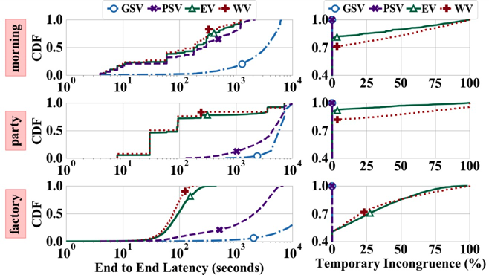
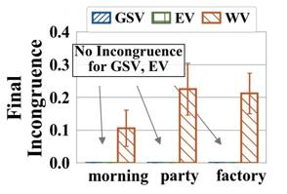
Real-World Benchmark
EV has temporary incongruence comparable to WV
EV is almost as fast as status quo (WV)
EV is serially equiva-lent, but WV not
Temporary Incongruence: the ratio of time when intermediate state is not serially equivalent.
Final Incongruence: the ratio of runs that end up in an incongruent state.
Notes:
In the evaluations, we measured multiple metrics, but here we focus on the end-to-end latency,
temporary incongruence which measures the incongruence of intermediate state, and
final Incongruence which measures the incongruence of system end state.
We can see that the green line EV, is almost as fast as the status quo system WV.
EV provides comparable but slightly better temporary incongruence to WV.
But, the incongruence in EV is only temporary.
When the routines are done, EV can fix these incongruence and provide serial equivalent end state. However, the status quo design WV cannot.

Slide 20
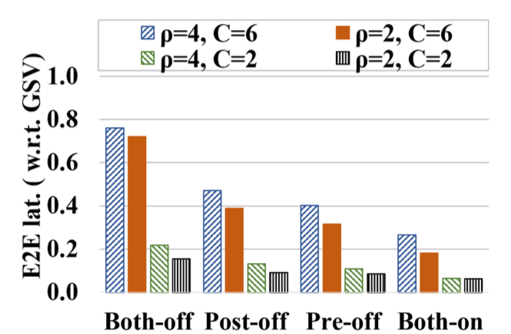
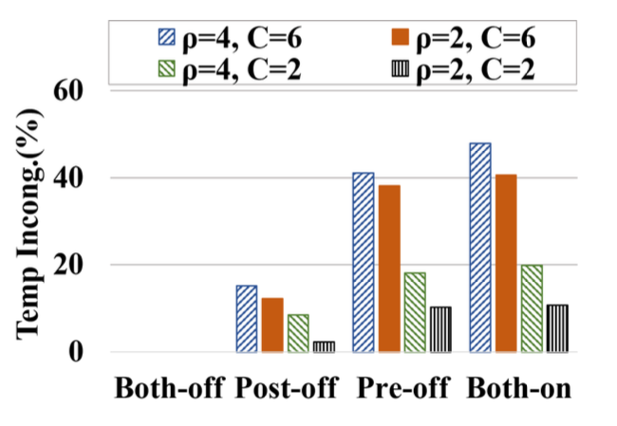
Workload Evaluation -- Pre/Post-Lease
High Latency, Zero Temporary Incongruence
Low Latency, High Temporary Incongruence
Pre/Post leases reduce the E2E latency (user-facing metrics) with the cost of Temporary Incongruence
Notes:
We also find out and evaluate how pre- and post lease reduce latency with the cost of temporary incongruence
When both mechanisms are OFF, SafeHome runs with longer latency but zero temporary incongruence.
If both mechanisms are ON, the routines finish with shorter latencies but higher temporary incongruence.

Slide 21
Takeaways
Safehome is a first step to provide reliability from routine execution level
SafeHome provides four Visibility Models (WV, EV, PSV, and GSV)
Eventual Visibility (EV) model provides the best of both worlds, with:
Good user-facing responsiveness (0 - 23.1%)
Strongest end state congruence equivalent guarantee (as GSV)
Lock-leasing improves latency by 1.5X - 4X
For questions: contact author Rui Yang <ry2@illinois.edu>
DPRG: http://dprg.cs.uiuc.edu/
Home, SafeHome:
Smart Home Reliability with Visibility and Atomicity
21
Notes:
In summary, Safehome is a first step to provide reliability from routine execution level. It provides four Visibility Models, among which EV model provides the best of both world with good responsiveness and strong guarantee. Our proposed lock-leasing mechanism1 can improve latency up to 4 times.
Here is my presentation for Safehome. Thanks for listening.

Slide 22
Eventual Visibility (EV) - Lineage Table
Lineage Table: SafeHome's plan of which routine will access which device.
[A]: Get lock Access
[S]: Routine Scheduled
[L]: Lock Leased out
[R]: Lock Released
R1[A]
R2[S]
R3[A]
R1[L]
R2[S]
R4[A]
Scheduling plan placement:
Placed when routine is triggered
Use backtracking for valid placement
Explore two other policies (FCFS, JiT)
R5[R]
R4[A]
Notes:
Safehome manages the logic of EV with lineage table. It maintains, at each time, which routine will access which device.
Here is the lineage table for our example. Each table entry is marked with status of
Holding the device access,
Scheduled,
Lock leased out, or
Lock released
The table entries are constructed when routine is triggered.
To reduce the search space, SafeHome utilizes backtracking to decide valid routine placement.
We also explores two other scheduling policies of First-Come-First-Serve and Just-in-Time. If you are interested in more details on this slide, welcome to read the paper.
So far, the designs are focusing on the serial equivalence. But there is another property that we care about, which is atomicity. It relates to the design when failure happens.
We also explores two other scheduling policies of First-Come-Fist-Serve and Just-in-Time. If you are interested in more details about the lineage table and these scheduling policies, welcome to read the paper.

Slide 23
Eventual Visibility (EV) - Lineage Table
Lineage Table: SafeHome's plan of which routine will access which device.
[A]: Get lock Access
[S]: Routine Scheduled
[L]: Lock Leased out
[R]: Lock Released
R1[A]
R2[S]
R3[A]
R1[L]
R2[S]
R4[A]
Scheduling plan placement:
Placed when routine is triggered
Use backtracking for valid placement
Explore two other policies (FCFS, JiT)
R5[R]
R4[A]
Notes:
Safehome manages the logic of EV with lineage table. It maintains, at each time, which routine will access which device.
Here is the lineage table for our example. There are four possible states for each table entry.
A means the routine is holding the device,
S means the routine is scheduled.
L means the lock is leased out and
R means routine has finished and the lock has been released.
The table entries are constructed when routine is triggered.
To reduce the search space, SafeHome utilizes backtracking to decide valid routine placement.
We also explores two other scheduling policies of First-Come-First-Serve and Just-in-Time. If you are interested in more details on this slide, welcome to read the paper.
So far, the designs are focusing on the serial equivalence. But there is another property that we care about, which is atomicity. It relates to the design when failure happens.
We also explores two other scheduling policies of First-Come-Fist-Serve and Just-in-Time. If you are interested in more details about the lineage table and these scheduling policies, welcome to read the paper.

